Slide 1

AI ACCELERATOR ARCHITECTURE FOR SECOND MODEL
Sparsely Embedded Convolutional Detection — Hardware-Aware LiDAR 3D Object Detection under Adverse Weather
Final Project Evaluation
by
Yash Agrawal (2025ICDT-010)
Master of Technology of Integrated Circuit Design and Technology
Atal Bihari Vajpayee-Indian Institute of Information Technology and Management, Gwalior
Department
Electrical and Electronics Engineering
Supervisor
Prof. Manisha Pattanaik
Co Supervisor
Er. Ankit Kumar (P.H.D.)
12 November 2026
Dated:
LiDAR point clouds → Fog-physics augmentation → SECOND Model profiling → Syncing With Appropriate Board → Implementation

Slide 2
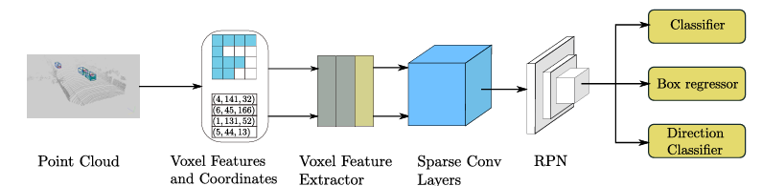
PROJECT DEFINITION
Objective & Scope
Execute the trained, validated, cross validated and tested SECOND Model On FPGA Board— the SECOND AI model for 3D Object Detection
Analyze SECOND's computation layer-by-layer: sparse 3D convolution backbone, BEV(Bird Eye View) reshape, and 2D RPN (region Proposal Network) detection head.
Identify computational and memory requirements to guide hardware mapping and dataflow design.
Define the complete implementation path through RTL, and Implement it On Appropriate Board (Probably, Genesys 2)
Study robustness of the target workload on fog-degraded point clouds, to keep the Model design weather-aware
Working title: Hardware Accelerator Architecture for SECOND-Model Based LiDAR 3D Object Detection under Adverse Weather
SECOND Model Accelerator Architecture | ABV-IIITM Gwalior | Weekly Progress — Review 1
2

Slide 3
MODEL SELECTION RATIONALE
Why SECOND Model for Hardware Acceleration?
Regular compute pattern
Sparse conv is dominant
One-stage, voxel-based detector — no irregular point-based refinement stage, unlike two-stage models (e.g., PV-RCNN).
Sparse 3D convolution is the single largest compute block — a well-studied, well-bounded target for custom dataflow.
Proven accuracy/efficiency
Right scope
Established KITTI baseline (Car/Pedestrian/Cyclist, easy/moderate/hard) — gives a credible reference point.
Lower architectural complexity than PV-RCNN++ — feasible to carry through RTL and Implementation on Appropriate Board (Probably, Genesys 2) in this timeline.
SECOND Model Accelerator Architecture | ABV-IIITM Gwalior | Weekly Progress — Review 1
3

Slide 4
THIS WEEK'S READING
Literature & Codebase At a Glance
Source | Focus | Relevance to this project
Shinde et al., 2024 | Fog particle-size distribution (Gamma/Junge) effects on 3D detection accuracy | Shows how droplet-size modeling changes attenuation/backscatter and class-wise accuracy
Liu et al., 2022 (Parallel LiDARs) | Mie-theory-based attenuation/backscatter, evaluated on PointPillars, SECOND, PointRCNN | Directly evaluates SECOND under four fog types — a useful accuracy reference
Hahner et al. (paper + GitHub repo) | Physics-based fog simulation on real LiDAR point clouds | Source of the simulation pipeline used this week to generate fog-augmented point clouds
Yan Yan et al., 2018 | SECOND : Sparsely Embedded Convolutional Detection | Mechanism of The SECOND Model
SECOND Model Accelerator Architecture | ABV-IIITM Gwalior | Weekly Progress — Review 1
5

Slide 5
SYSTEM UNDERSTANDING
SECOND Model: Pipeline & Hardware-Critical Operations
Raw LiDAR
points
Voxelization
Sparse 3D conv
backbone
Reshape
to BEV (Bird Eye View)
2D conv
RPN
Anchor head
+ NMS
Orange = the two most hardware-critical, compute-heavy stages
Sparse 3D convolution (submanifold + regular) — dominant MAC count, irregular active-voxel addressing.
Voxel feature encoding — per-voxel point aggregation before the backbone.
Dense 2D convolution in the Region Proposal Network (RPN) over the BEV feature map.
Anchor-based detection head and Non-Max Suppression (NMS).
SECOND Model Accelerator Architecture | ABV-IIITM Gwalior | Weekly Progress — Review 1
4

Slide 6
PHYSICS STUDIED THIS WEEK
Fog Simulation: What Was Understood
Core relations
α (attenuation) governs point loss / signal decay with range.
β (backscatter) governs false / soft-target returns — the visual “fog noise.”
Gamma and Junge distributions model droplet-size N(D) for different fog severities.
T(R) = exp(−αR)
One-way transmission loss over range R
Hard-target return ≈ exp(−2αR) × P_clear(R)
α, β obtained by integrating Mie efficiencies over droplet-size distribution N(D)
Hahner LiDARfogsim repository
• fog_simulation.py — augments clear-weather point clouds with the physics above
• theory.py — single-beam fog return model, matched against the paper equations
• Precomputed integral lookup tables for α, β — avoids re-solving the Mie integrals at runtime
SECOND Model Accelerator Architecture | ABV-IIITM Gwalior | Weekly Progress — Review 1
6

Slide 7
RISK AWARENESS
Challenges Faced till now
Challenge | Mitigation / next step
Setting up the sparse-convolution / point-cloud toolchain (spconv, Open3D, CUDA) on Ubuntu | Pin package versions; document a reproducible install script
Interpreting the Mie-theory attenuation/backscatter code and matching it to the paper equations | Cross-check theory.py output against the values from the papers
Selecting fog severities (α, β) that meaningfully stress SECOND's sparsity pattern | Sweep severity levels and inspect active-voxel counts before committing to a test matrix
Implement The Model On Genesys 2 Board Because Of The Not So Familiar Compatibility With SECOND Model Python Code | Use AMD Vivado As a bridge To Fill The Compatibility Issue Gap, And, Use Divide and Conquer Approach To Implement SECOND Model on Genesys 2
SECOND Model Accelerator Architecture | ABV-IIITM Gwalior | Weekly Progress — Review 1
9

Slide 8
FPGA Choice: Genesys 2 (Kintex-7)
Resource | Genesys 2 (XC7K325T-2FFG900C)
Logic slices | 50,950 (4× 6-input Look Up Table (LUT) + 8 Flip Flop (FF) each)
Digital Signal processor (DSP) slices | 840
Block Random Access Memory (BRAM) | ≈ 16 Mega bit (Mb)
Max internal clock | > 450 Mega Hertz (MHz)
Onboard memory | 1 GB Dynamic Data Register 3 (DDR3) (1800 Mt/s)
Host link options | USB-JTAG/UART, Gigabit Ethernet, FMC HPC
840 DSP slices give a strong base for a MAC-heavy PE array (sparse + dense convolution).
Ample BRAM supports on-chip double-buffering of voxel/feature maps to cut external memory traffic.
From Trained Model to FPGA
PyTorch /
OpenPCDet
model
Export +
quantize
(INT8/16)
Weight/bias
binaries
(.coe/.mem)
Verilog RTL
accelerator
Vivado
synth +
impl.
Genesys 2/Pynq
bitstream
Host ⇄ FPGA runtime loop: Python on host PC streams a test point cloud / voxel grid to the board over UART or Gigabit Ethernet; the accelerator returns detections for comparison and visualization.

Slide 9
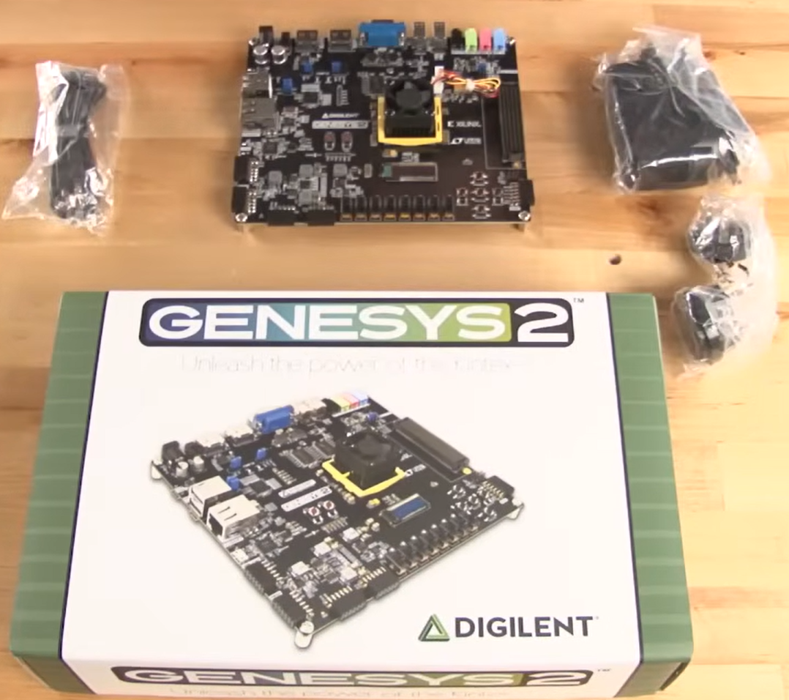

Slide 10
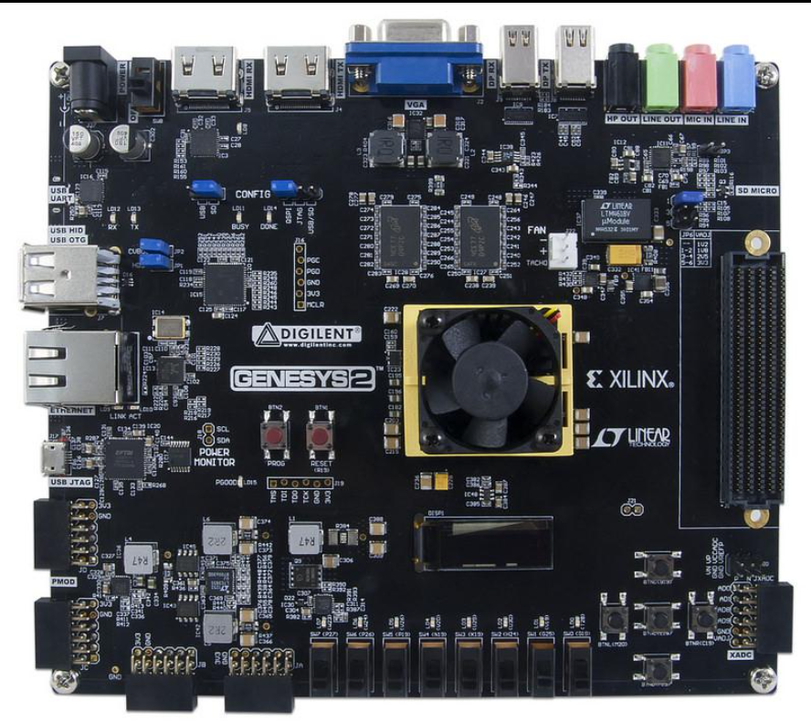
Genesys 2
Board’s
Bird Eye View

Slide 11
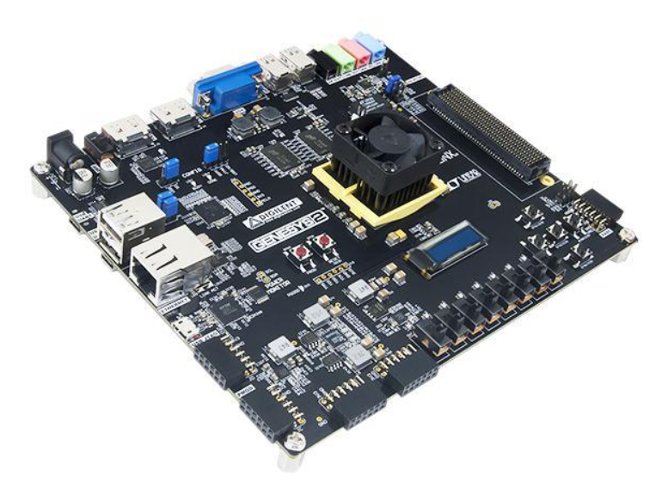
Genesys 2
Board
Side View

Slide 12
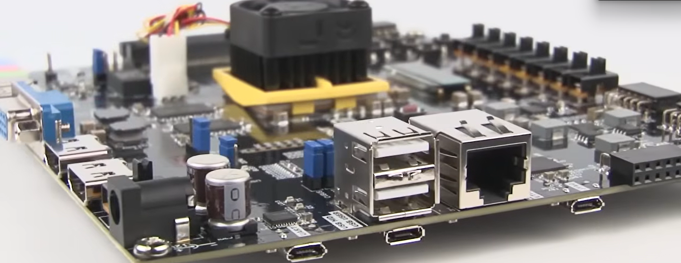

Slide 13
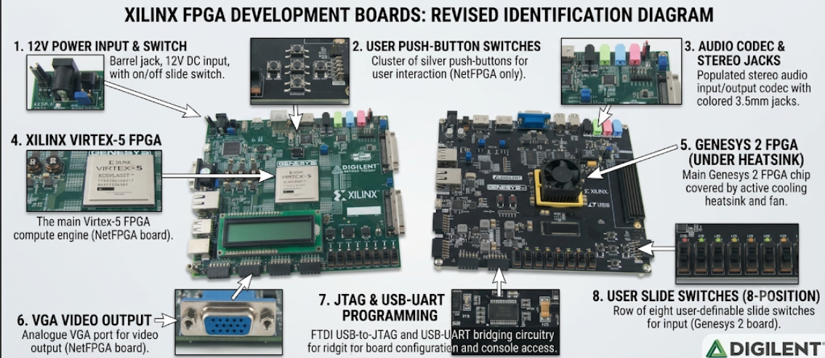

Slide 14
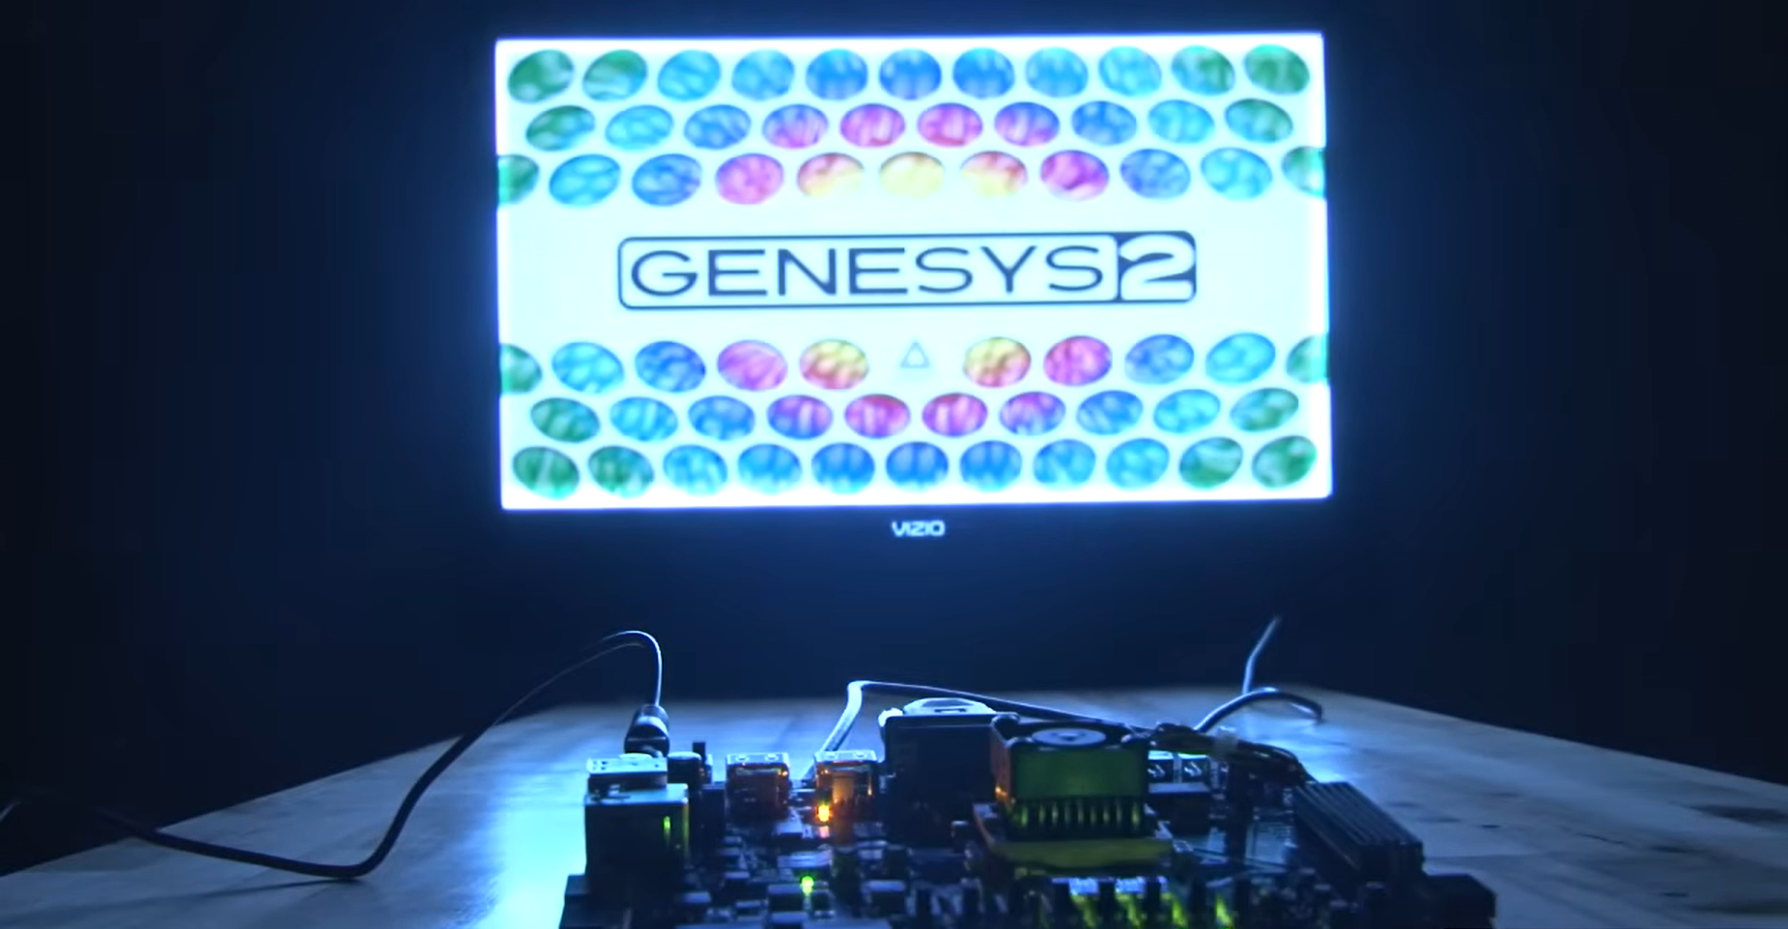

Slide 15
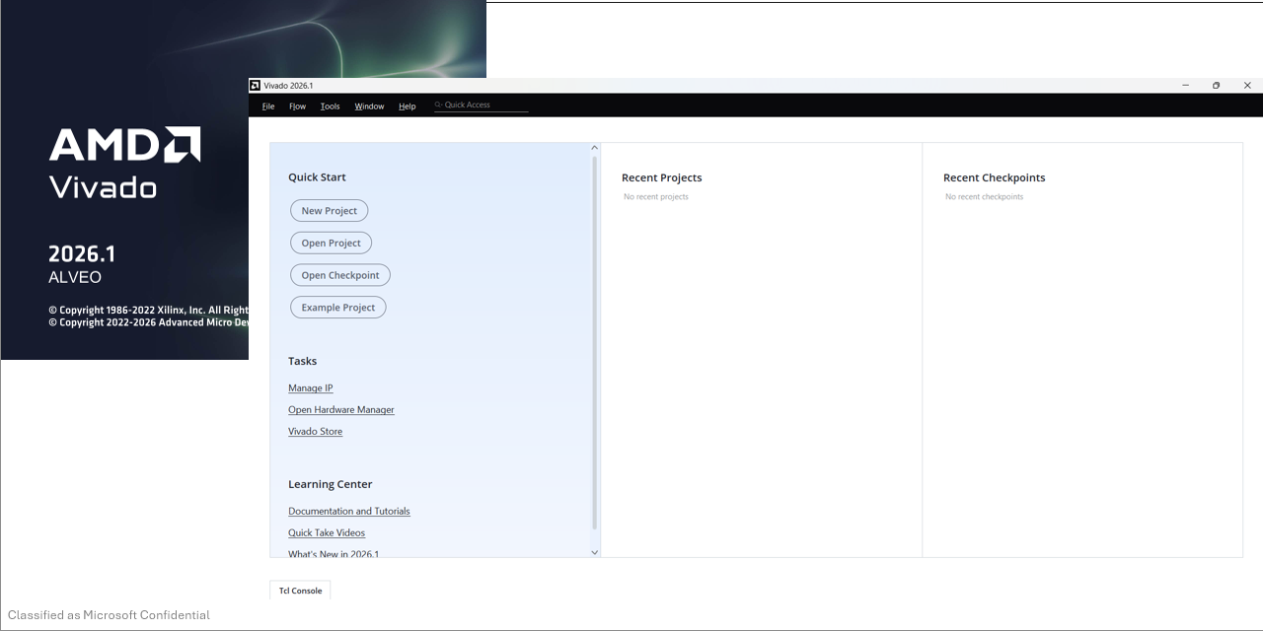
AMD VIVADO

Slide 16
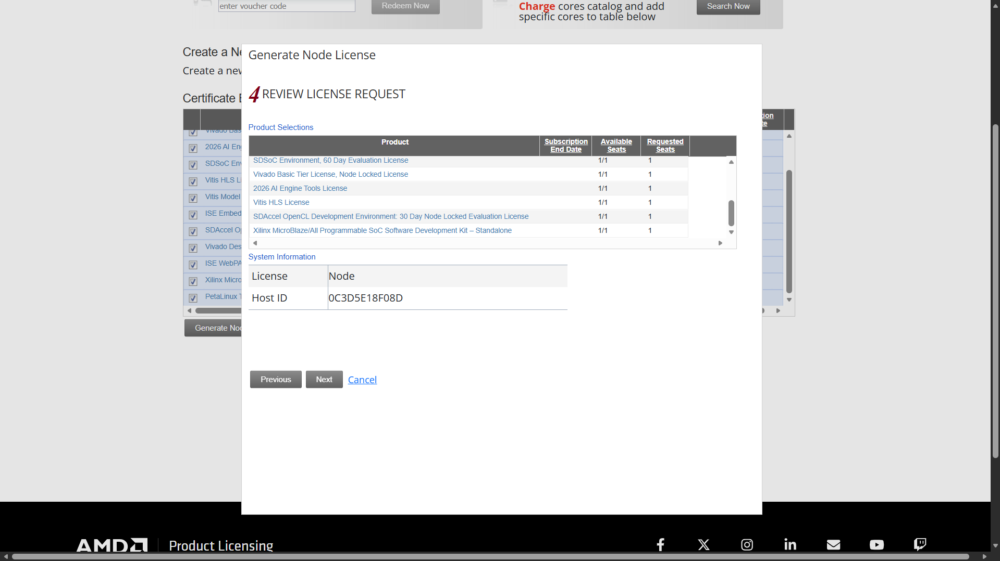

Slide 17
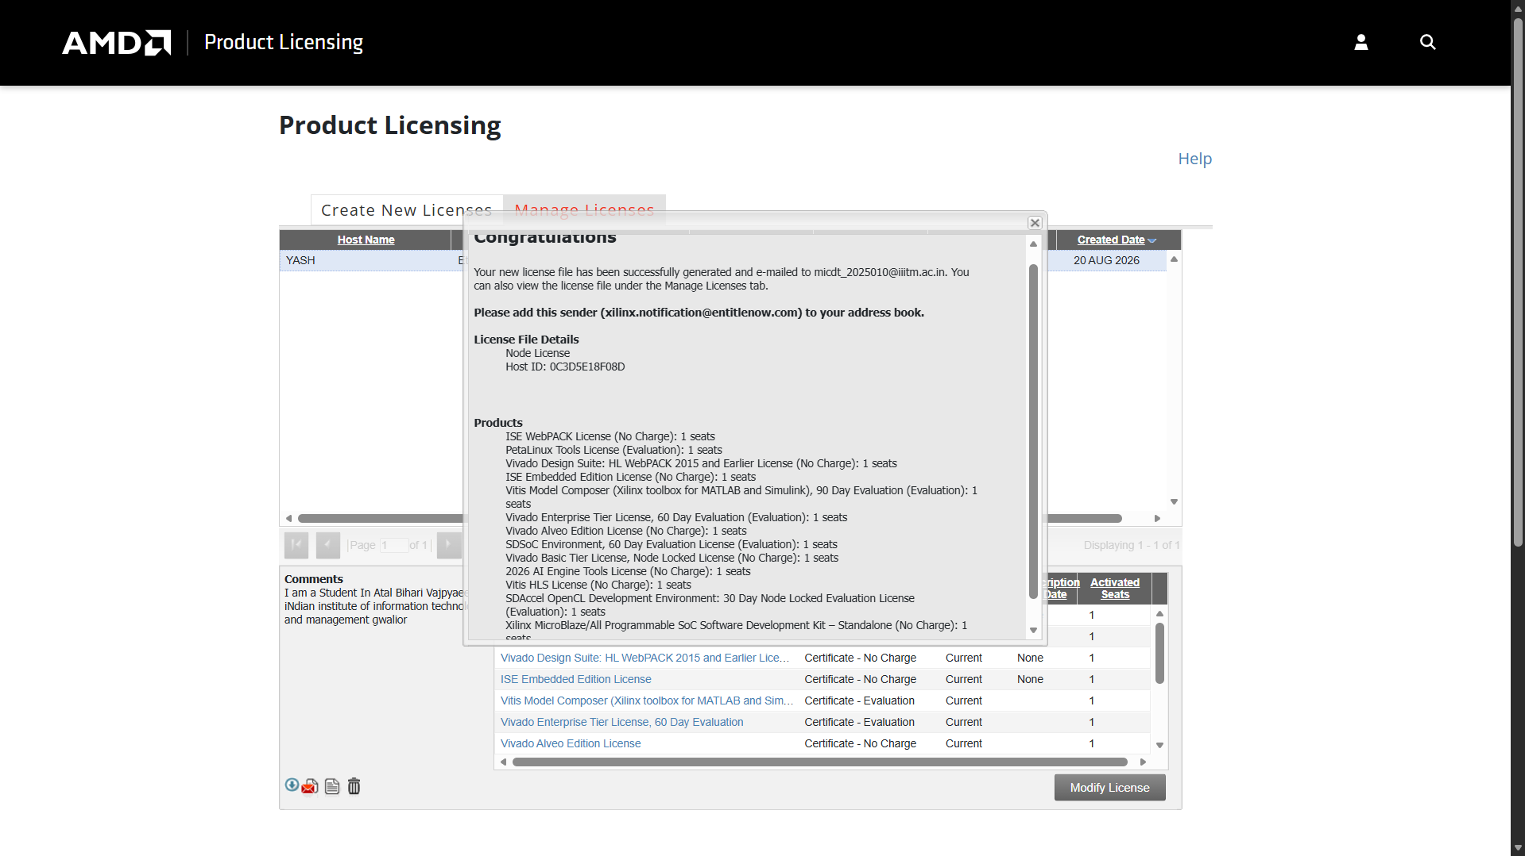

Slide 18


Slide 19
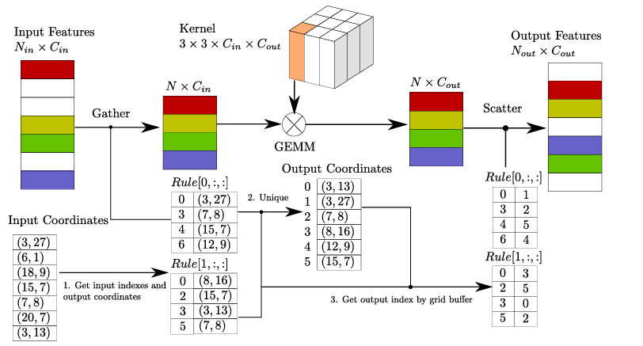
Software–Hardware Co-Verification
1
Generate golden reference vectors (layer activations + final output) from the PyTorch model on a fixed test input.
2
Quantize the same input and feed it into the Verilog testbench in simulation (Vivado Simulator); compare against the golden vectors, layer by layer.
3
Only after simulation matches, move to on-board bring-up — load the bitstream and stream the same test vectors from the host over UART/Ethernet.
4
Compare FPGA-captured output to the Python reference within a defined numerical tolerance before trusting any hardware result.

Slide 20
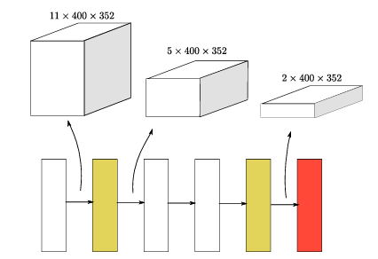
LOOKING AHEAD
Plan for the Future
1
Implement trained (On OpenPCDet’s KITTI dataset), validated, cross validated and tested- SECOND model (in Adverse weather also, instead of clear weather only) on Genesys 2 Board
2
Generate a broader set of fog-augmented samples across multiple severity levels.
3
Begin layer-wise profiling of SECOND Model: active-voxel counts, operation counts, tensor shapes per layer.
4
Implement a trained, validated and tested- SECOND model (in adverse wheather) on Programmed Genesys 2 Board
SECOND Model Accelerator Architecture | ABV-IIITM Gwalior | Weekly Progress — Review 1
10

Slide 21
Rough Plan for implementing SECOND model on GENESYS 2 Board
Model weights live in a PyTorch .pth file, and the Genesys 2 can't read that format.
So, Weights would be exported to plain numbers, quantize them, and load them into the board's memory.
SECOND checkpoints are a few hundred MB. SECOND has about 5 million parameters, so the file should be much smaller, roughly 20 MB for weights alone and a few times that with optimizer state included.
The Genesys 2 can't run your Python. It has a Kintex-7 FPGA with no ARM CPU, so Python and PyTorch stay on your PC. The board runs hardware you design in RTL, HLS, or a MicroBlaze soft core, and your PC talks to it over UART or Ethernet.
The full SECOND model won't fit. Its sparse 3D convolutions (spconv) and voxelization don't map well to this FPGA, which has about 2 MB of block RAM, 840 DSPs, and 1 GB of DDR3. The realistic target is the dense part, the 2D BEV backbone and detection head, with the rest on the PC.
Step 1: Export the weights from the checkpoint
Step 2: Quantize to int8 and write memory-init files: Before quantizing, fold each BatchNorm into its preceding conv. That removes extra hardware, and it's standard practice.
Step 3: Get the weights onto the board
Small layers: initialize BRAM directly from the .mem or .coe file in Vivado ($readmemh in RTL, or the Block Memory Generator's .coe option).
Larger layers: to be stored in the 1 GB DDR3 and load them from the SD card at boot, or send them over UART or Ethernet through a MicroBlaze.
Checking: run the same input through PyTorch and the board, then compare outputs layer by layer.
Which toolflow is being used on the board: hand-written Verilog/VHDL. The loading method and the weight layout both depend on it, so the code is different for that path.

Slide 22
STATUS
Work Completed Till Now
✓
Read and summarized 3 papers on fog-particle physics and its effect on LiDAR 3D detection.
✓
Studied Martin Hahner's LiDARfogsim GitHub repository — simulation entry point, theory implementation, lookup tables.
✓
Set up the Python / Ubuntu environment (previously named foggy_lidar -> yash_ai_accelerator ) and used the basic point clouds (velodyne) of clear-weather LiDAR scans for The SOC project
✓
Mapped The Trained SECOND Model’s operator pipeline to identify the hardware-critical stages for accelerator design, Trained, SECOND Model On Clear weather
Not yet completed: Implementation On Genesys 2 Board.
SECOND Accelerator Architecture | ABV-IIITM Gwalior | Weekly Progress — Review 1
7

Slide 23
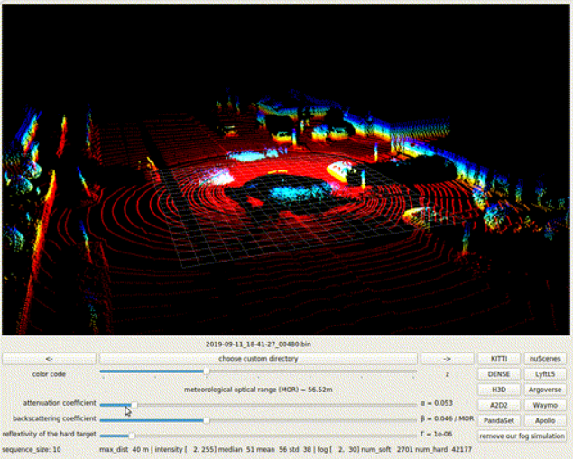
Fog-Augmented Point Clouds (Example Point Cloud Image with fog)
[ Insert your point-cloud screenshot(s) here —
e.g. clear vs. fog-augmented, from your Python/Open3D visualization ]
: “Clear-weather vs. fog-augmented KITTI point cloud, generated using the Hahner fog-simulation pipeline.”
8

Slide 24
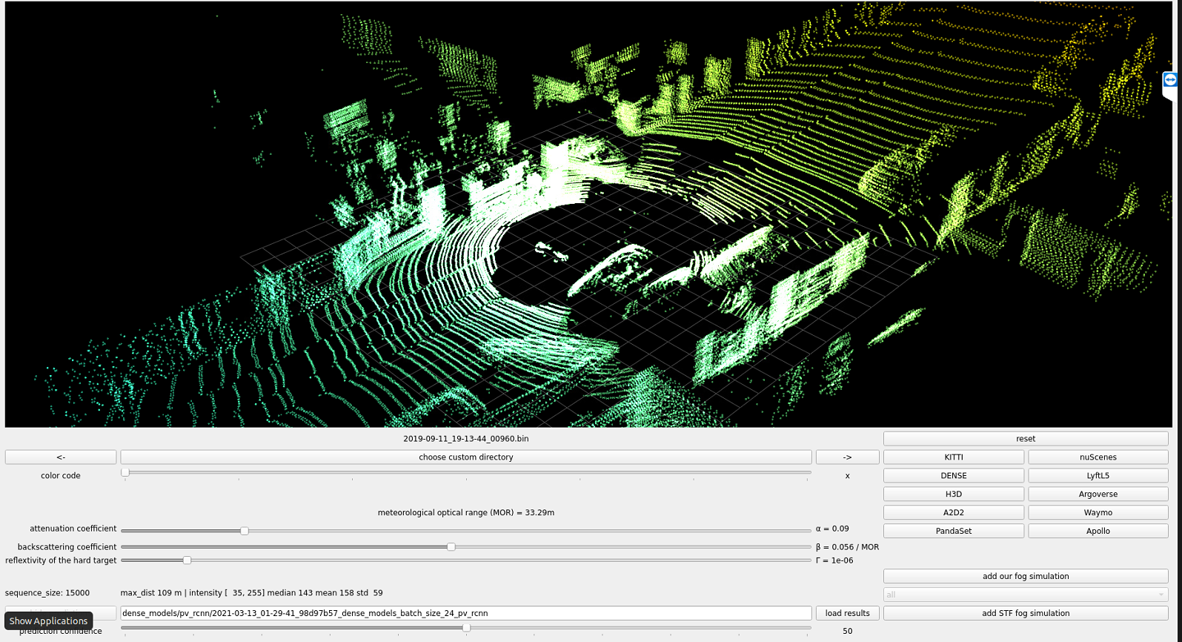
Fog-Augmented Point Clouds (Example Point Cloud Image with fog In negative)
[ Insert your point-cloud screenshot(s) here —
e.g. clear vs. fog-augmented, from your Python/Open3D visualization ]
: “Clear-weather vs. fog-augmented KITTI point cloud, generated using the Hahner fog-simulation pipeline.”
8

Slide 25
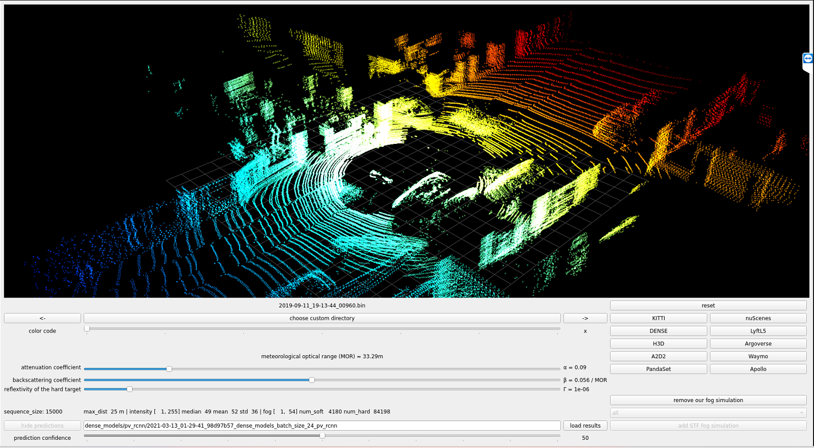
Fog-Augmented Point Clouds (Example Point Cloud Image with fog from different angle)
[ Insert your point-cloud screenshot(s) here —
e.g. clear vs. fog-augmented, from your Python/Open3D visualization ]
: “Clear-weather vs. fog-augmented KITTI point cloud, generated using the Hahner fog-simulation pipeline.”
8

Slide 26
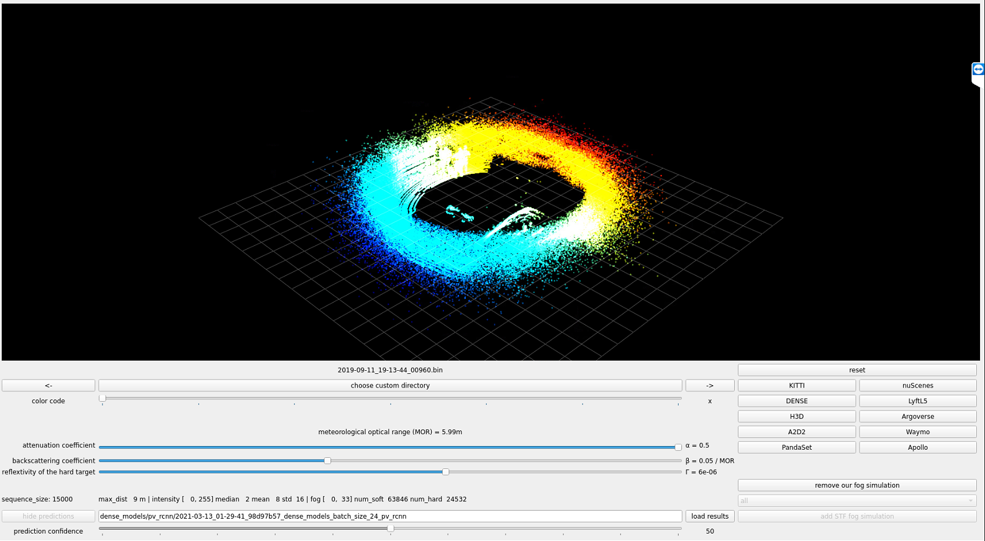
Fog-Augmented Point Clouds (Example Point Cloud Image with very dense fog, Martin Hahner )
[ Insert your point-cloud screenshot(s) here —
e.g. clear vs. fog-augmented, from your Python/Open3D visualization ]
: “Clear-weather vs. fog-augmented KITTI point cloud, generated using the Hahner fog-simulation pipeline.”
8

Slide 27
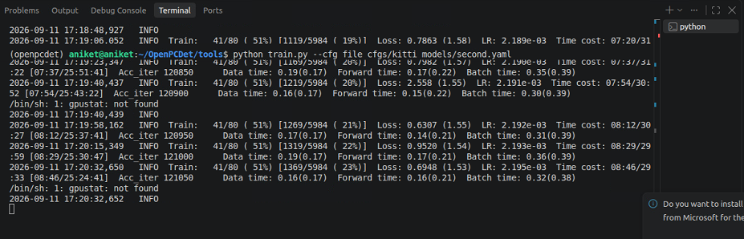
ReTraining Of Second Model (on Clear Wheather) To Be Mapped For Hardware
Acceleration On FPGA Board (Probably Genesys2)

Slide 28
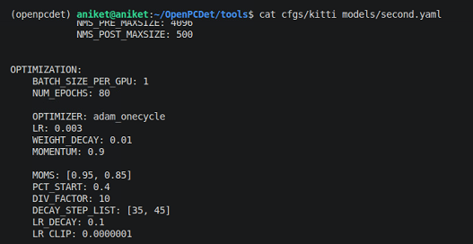
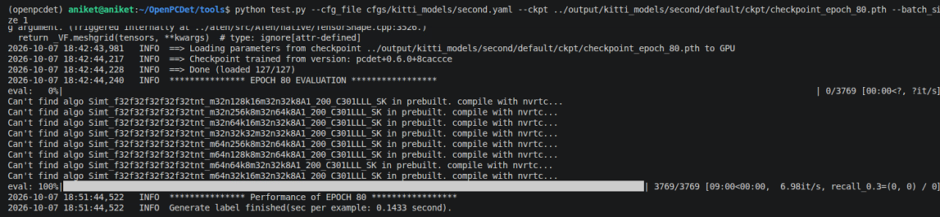
Second model configuration file
The Model Was fully trained Till Epoch 80 (please See right image), for results , PTO

Slide 29
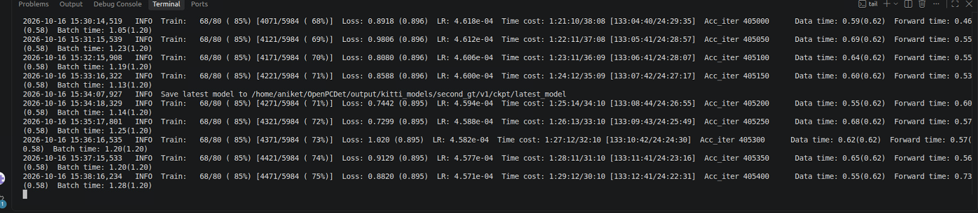
Final Training Of Second Model (For clear Weather) To Be Mapped For Hardware Acceleration On FPGA Board (Probably Genesys2)

Slide 30
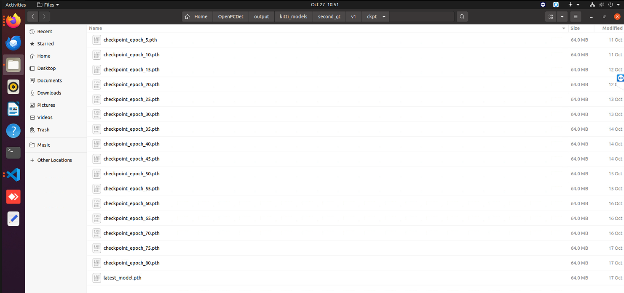
Insights On Final Trained Second Model (For clear Weather) To Be Mapped For Hardware Acceleration On FPGA Board (Probably Genesys2)

Slide 31
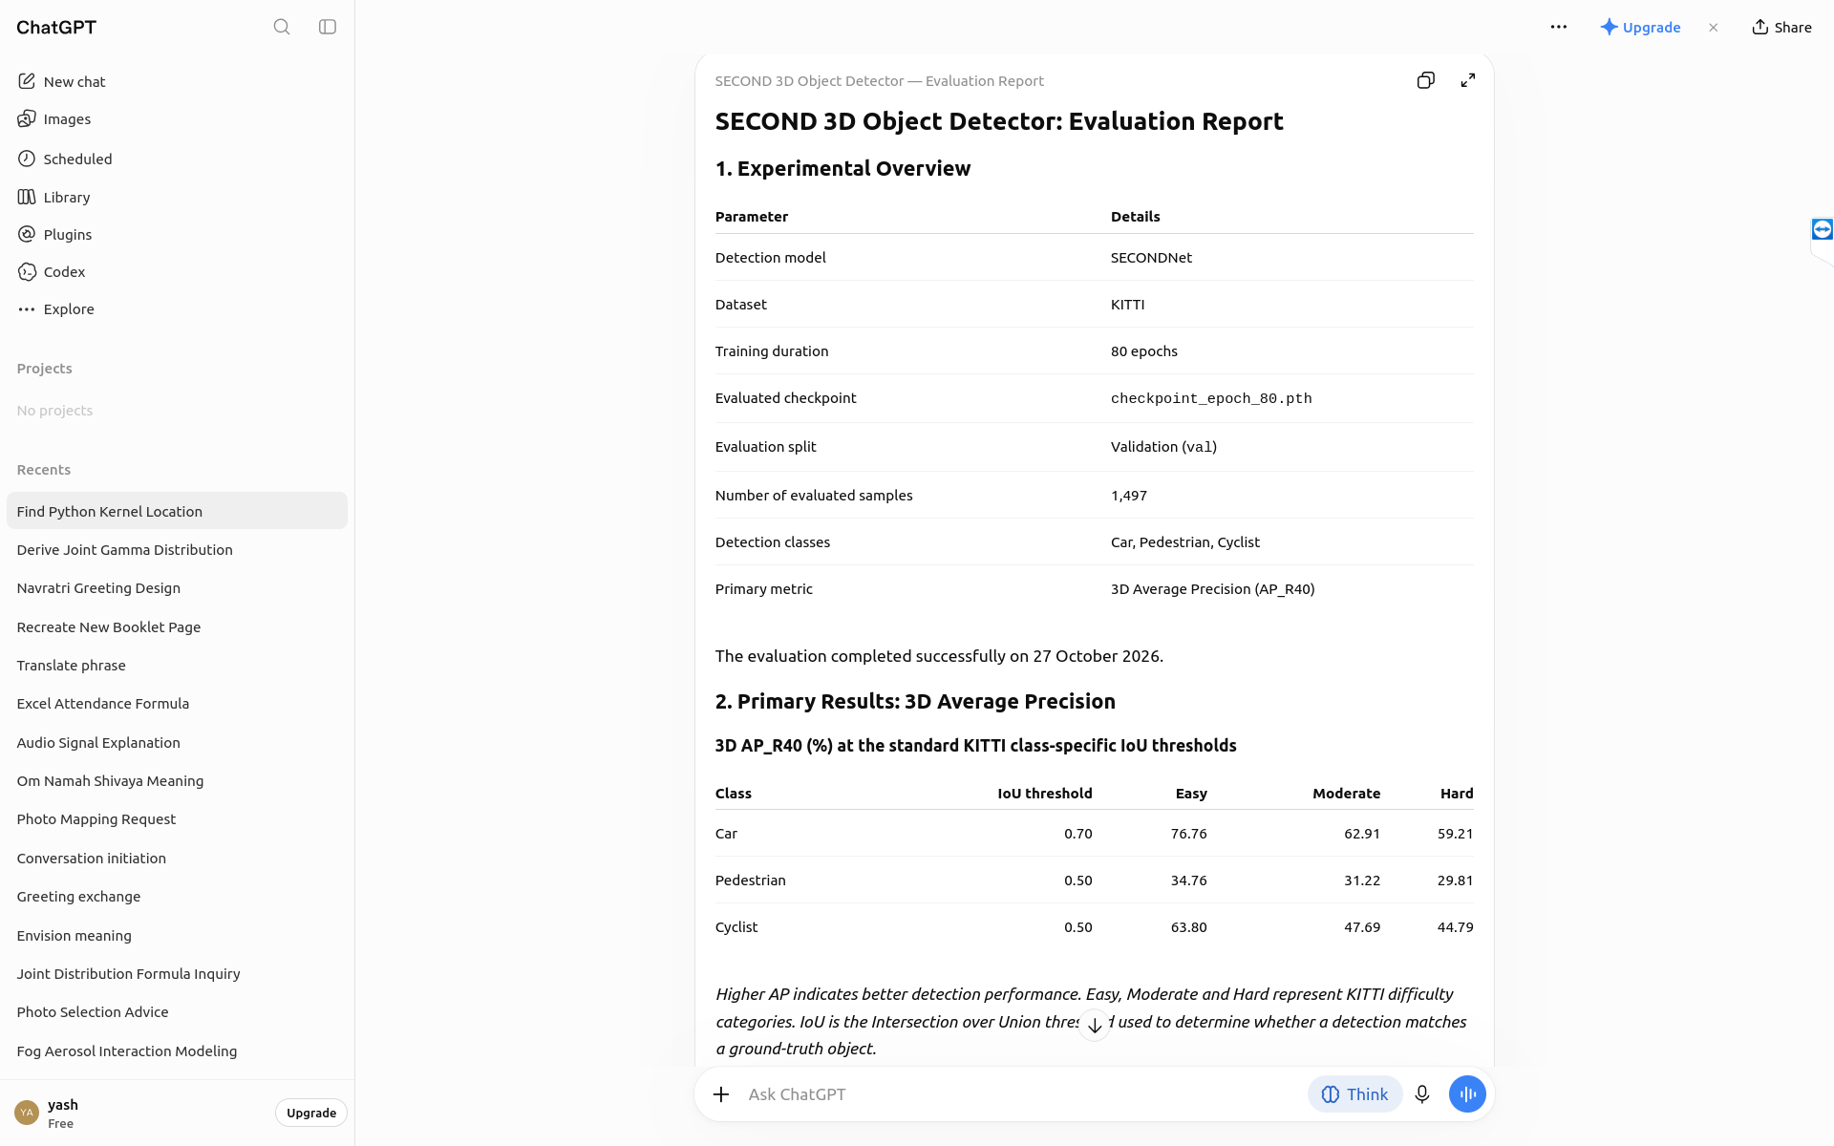

Slide 32
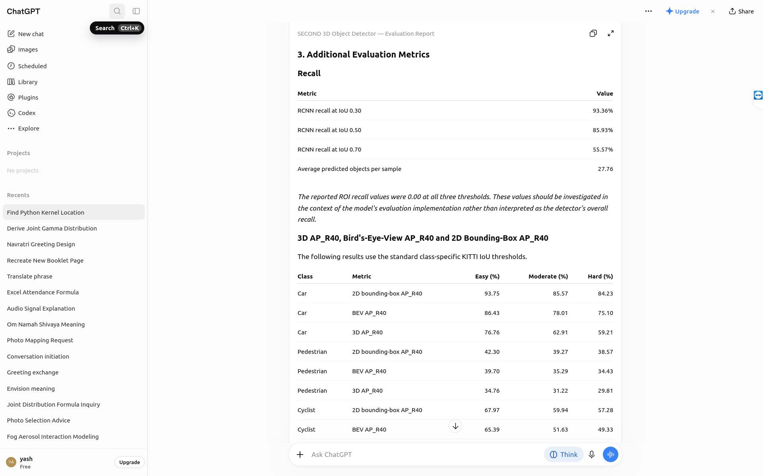

Slide 33


Slide 34
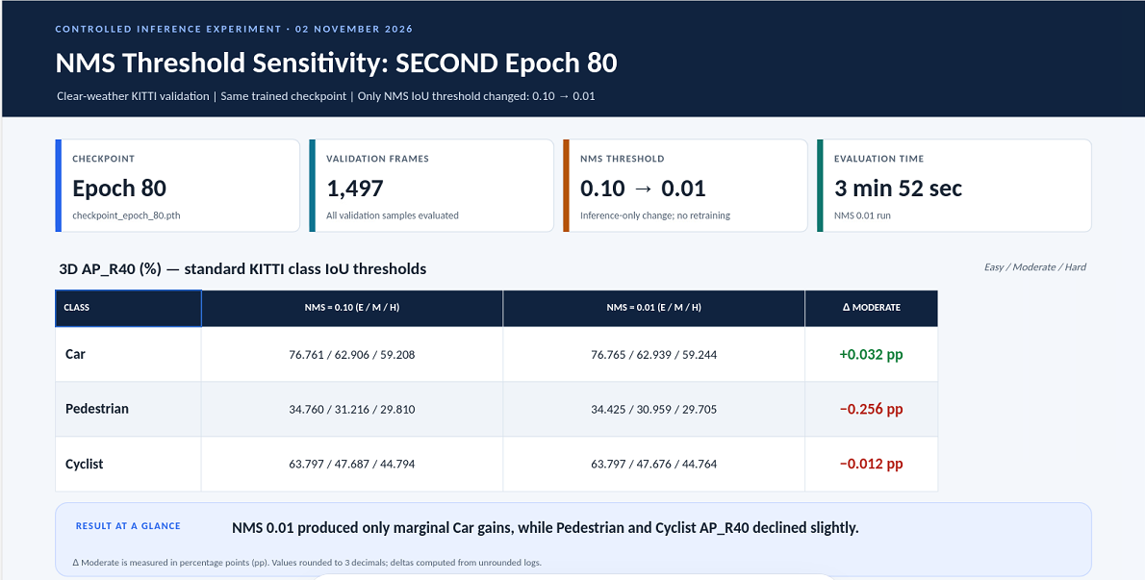
A Brute Force Experiment To Make SECOND Model Best Rather Than Better (By Fine Tuning Hyper Params)

Slide 35
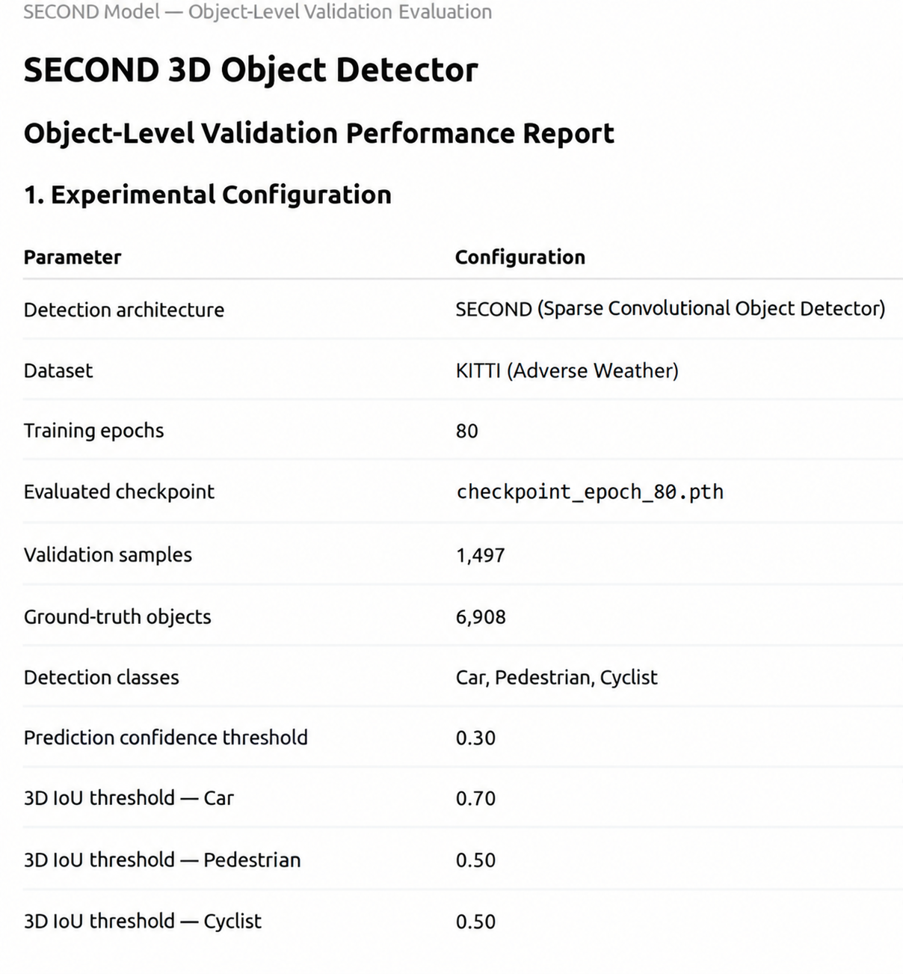
Insights
On
Validated (Final Trained)
SECOND Model
(For clear Weather)
To
Be
Compared
With
Results of
Validated (Final Trained) SECOND Model
Mapped
For
Hardware
Acceleration
On
FPGA Board
(Probably Genesys2)
[The Existing predictions (←) were compared against the corresponding ground truth annotations in kitti_infos_val.pkl]

Slide 36
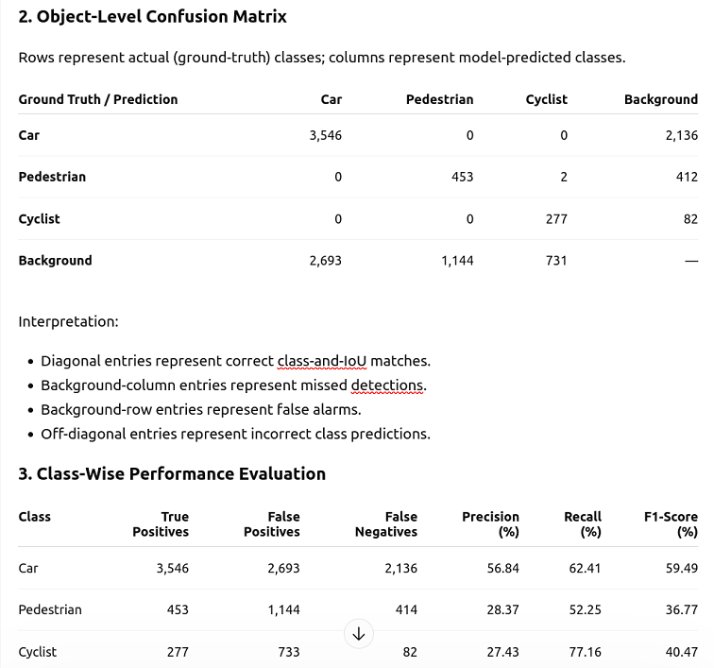
Insights
On
Validated (Final Trained)
SECOND Model
(For Clear Weather)
To
Be
Compared
With
Results of
Validated (Final Trained) SECOND Model
Mapped
For
Hardware
Acceleration
On
FPGA Board
(Probably Genesys2)
[The Existing predictions (→) were compared against the corresponding ground truth annotations in kitti_infos_val.pkl]

Slide 37
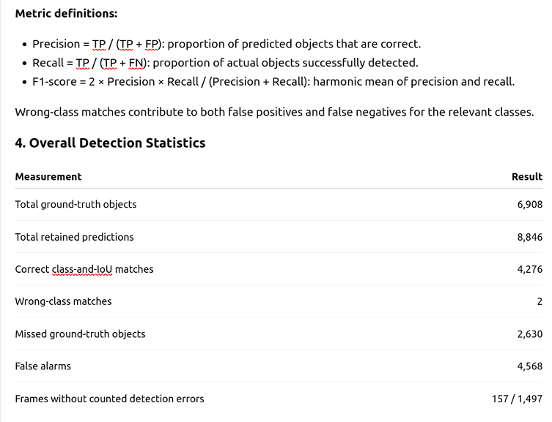
Insights
On
Validated (Final Trained)
SECOND Model
(For Clear Weather)
To
Be
Compared
With
Results of
Validated (Final Trained) SECOND Model
Mapped
For
Hardware
Acceleration
On
FPGA Board
(Probably Genesys2)
[The Existing predictions (←) were compared against the corresponding ground truth annotations in kitti_infos_val.pkl]

Slide 38
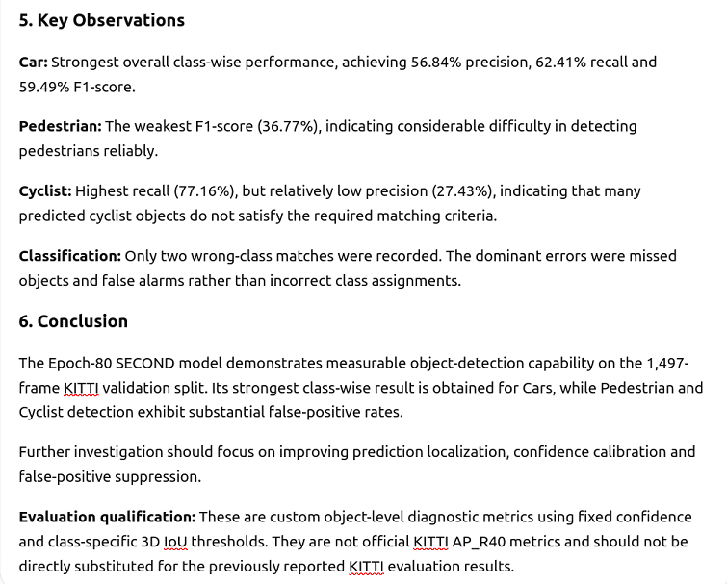
Insights
On
Validated (Final Trained)
SECOND Model
(For Clear Weather)
To
Be
Compared
With
Results of
Validated (Final Trained) SECOND Model
Mapped
For
Hardware
Acceleration
On
FPGA Board
(Probably Genesys2)
[The Existing predictions (→) were compared against the corresponding ground truth annotations in kitti_infos_val.pkl]

Slide 39
Results Final {after (epoch 80, val split) } But On Clear Kitti Data (No Adverse Weather)
Class | Metric | Easy | Moderate | Hard
Car | 3D AP_R40 @ IoU 0.70 | 59.3 | 47.9 | 44.5
Pedestrian | 3D AP_R40 @ IoU 0.50 | 8.5 | 7.8 | 7.3
Cyclist | 3D AP_R40 @ IoU 0.50 | 6.2 | 3.9 | 3.6
IoU threshold | Recall
0.3 | 86.6%
0.5 | 74.7%
0.7 | 44.8%
~/OpenPCDet/output/kitti_models/second/default/ckpt/checkpoint_epoch_80.pth””,
contains weights, which would be exported to genesys 2 board, PTO

Slide 40
Insights On Training Of Second Model To Be Mapped For Hardware Acceleration On
FPGA Board (Probably Genesys2)
Source Code Of Second Model Was Taken From Github (GitHub - open-mmlab/OpenPCDet: OpenPCDet Toolbox for LiDAR-based 3D Object Detection. · GitHub)
Weather condition | Car | Pedestrian | Cyclist
Clear weather {One of the best of LIterature} | 78.62 | 52.98 | 67.16
Fog sim. [Hahner et al.] (one of the best of the literature) | 77.63 | 45.40 | 55.64
Strong advection fog (one of the best of the literature) | 76.69 | 46.92 | 47.73
Moderate advection fog (one of the best of the literature) | 78.11 | 47.39 | 58.40
Strong spray (one of the best of the literature) | 78.34 | 48.24 | 58.48
Car class stays nearly flat across all fog types — large, dense point returns are robust to attenuation.
Pedestrian and Cyclist degrade sharply under strong advection fog (−20 and −19 AP) — fewer points per object, more sensitive to loss.
This is the exact robustness gap our accelerator's data path needs to tolerate — informs which classes to prioritize when validating hardware precision choices. KITTI remains our primary benchmark for this project
References : Y. Liu, Y. Tian, B. Sun, Y. Wang, F.-Y. Wang, “Parallel LiDARs Meet the Foggy Weather,” IEEE J-RFID, 2022. 3D AP, moderate difficulty.

Slide 41
Insights: Chapter I
There Are Many Thresholds For Detection Of 3D Object: viz: AP_R40, AP_R11, and AP_R21
The Practice Of Implementing 3D Model (In This Case, SECOND (Sparse Embedded Convolution) Model) On Board, Is because Of Making The Process of Detection Quick Enough (Because In Real Time, Every Moment Counts (else There will be accident)), And, This Speed Is Accomplished By, Designing Hardware According To Software Program Of That 3D Model (Like A Tailored Fit Costume, Looks So Awesome).
Now This Designing Can Be Done By Either Semi Custom Method (Like, We Have To Write RTL Code (in Verilog), in order to configure FPGA Board (Like, AMD VIVADO), or we can write high level RTL Code (In C++), in order to configure FPGA Board (Like, AMD VITIS), Or,
For This Designing, We Can Proceed Through Full Custom Method (ASIC (Analog Specific Integrated Circuit) Flow (which Has Some Popular Milestones, like, Schematic → Check Whether Schematic Is Working Properly (ADE-L) → Layout → DRC → If No Errors in DRC→ Layout Vs Schematic (LVS) → Parasitic Extraction (PEX) → Post Layout Simulation → PVT Analysis (Either Grid Search, Or Monte Carlo Simulation (Professionally Preferred) → Correct If Not Ok→ GDSII (The Blue Print Of Actual Chip (Before Fabrication) → GDSII File Sent To Fabrication, where it is critically Reviewed by Industry Experts Till File Meets Standards → Fabricate (It Takes At least 6 month To Get Fabricated Chip In Best Case))

Slide 42
Insights: Chapter II
Though There Are Many Models For 3D Object Detection (3DOD) (say, Transformer Models, most advanced),And Many Datasets Too (Say, Derivatives Of KITTI, Waymo, NuScene), But For A Basic Foundation, SECOND Model and KITTI Dataset is, one of the perfect combo For Understanding The Mechanism Behind This Artificial Intelligent Accelerated Hardware Process.
For Implementing A Artificial Intelligent Software Program (AI Agent) On Board, We Need To Check If,The Board Has Required Memory (Registers) (Also, We Need To Pay Attention On Scheduling of Instructions by AI Agent And Design Our RTL Code Accordingly, Else, We can only implement a module of AI Agent, On Board, and in that too, we need to check whether, The AI Agent Is Functioning Well Overall → if Yes → Is It Detecting Object In Less Time (With Same Accuracy, when it was implemented on System (Say, Desktop on which AI agent code is coded and runned) itself), and if this stage is passed → if Accuracy Can Be Better → If This Stage Is Passed Too → If This AI Hardwares Accelerator’s productivity can be made better (Fine Tuning The Balance Between, Precision, Recall, F1-Score, Accuracy, Hypothesis) (In These Types Of Detection Problems, We Go For Feasible Solution, Rather Than Optimum Solution, Because, Else It Would Be So Complex (For Me At least)
Generating A Feasible Solution For 3DOD, Generally Takes, 6 Months, At An Average (This Is Why This Project Was expected to be Finished By Me in 6 Months (Which In My Case is in Semi Final Stage, To The Best Of My Knowledge)
Popular Candidates (Boards) For Implementing This 3DOD project are: Genesys2, Zynq, Pynq, NVIDIA Board

Slide 43
Insights: Chapter III
The AI Agent Is Coded In Python, And, The Code Of Nearly All AI Agents (Whatever (So Less) Work done by me, are available in GITHUB, In My case, This Project Used, OpenPCDet Github Repository, which could be Forked (online), or, we could import the repository completely on say, local desktop (offline).
This Repository contains, a file, something like, second_model.yaml, which contains meta data of Second Model, Like Hyperparameters, which could be tuned, for example, with help of “nano” command in linux, we can edit, Program (AI Agent), Say, Learning Rate Of Optimizer (Since In This Case Our Training Dataset Contains Point Clouds, So We are Using Appropriate Optimizer, But In Case Of 1D CNN, Adam Optimizer, Is one of the famous. Other, Hyperparameter, say, Batch Size (Depends On GPU Capability), Other Parameter, say, Voxel Size (X,Y,Z). Other, might be Number of Epochs (Best Practice Is To, Run Over, Many Epochs, And Draw A Graph Between, Performance (Say, Accuracy), with respect to Epochs, and see, which check point performed best (but we Need to validate our trained model too, else, it our model be overfit or underfit)
state of the art AI Agents, Like, Claude, ChatGPT, Gemini, Only, Accelerate Your Performance. They Are Just Like Machines, Which can give you something analogus to Mechanical Advantage, So, They Can not Guide You, Unless You Know Prompt Engineering. Lack Of Prompt Engineering Skills, Will Only Create Lack In Your Performance. Better To Consult Supervisor (In Case of lack, You Can Blame Him At Last (or at least, present your work to him, to the best of your knowledge)), but in that also, you need communication skills, Hence, We Should Do Our Best Investment (as much as possible) In Honing Skills, to the best of my knowledge)
Basically, All These 3DOD Practices And Applications Are, Ultimately Be Going to be used in Military, I mean, Ranging from, Best Ones In So Senstitive Military Operations, To Worst Ones, Like mine, Just, As an Another Attempt In Learning

Slide 44
Insights: Chapter IV
Each Designing Method, Meaning, Either Full Custom (ASIC) Or, Semi Custom (Programming FPGA), Has got its Own Advantages and Disadvantages. For Example, In ASIC, One Might Get Stuck In So Many DRC Errors (In Calibre, Mentor Graphics, Cadence Virtuoso), But, May Find Schematic (The Beginning) So Entertaining!, Whereas, In FPGA Programming, One May Get Stuck In Debugging So Many Errors In Verilog Code, But, May Find, The Concluding Process, Like, Generating Bit Stream, Mapping Constraint File To Board, And Implementation So Easy.
One Important Process Before Tape out Of Chip, Is The PVT Analysis, Suppose, Hypothetically, A Chip, Is To Be Used In So Sensitive Military Operations (Like State of The Art Facilities, Say, Secure Vault Room Of CIA (Central Intelligence Agency) Head quarters in Langley, USA), which say, contains many important information, for example List Of Artificial Detail Of Spies, And Corresponding Actual Details of Spies (called The NOC list), which if in hands Of Enemy, Might Be So Haunting For USA, The Vault Is So Secure, That It Has Chip, which could detect any suspicious activity, with so sensitivity, and generate so complex network of alarming system. Now Suppose that chip had been not undergone, state of the art PVT Analysis, state of the art, monte carlo simulation (Or whatever be best practice and application there), then, to the best of my knowledge, it would not be so impossible mission to intrude that vault.
(To The Best Of My Knowledge, Monte Carlo Simulation, is Continuous version of Grid Search (in which, we have, say, 2 parameters, {pressure, temperature}, so we check, whether chip is working fine in say {p1=1atm, T1=298K}, {p2=1.005atm, T2=298.1K}, {p3=0.995atm, T3=297.9K}, and so on and so forth for n*m sets of {pressure, temperature})) (just a layman ex.)
An Opportunity Dose Not Come Again (Hopefully, It should be the ultimate truth, probably)

Slide 45
Summary
Target confirmed: SECOND Model— a sparse-convolution, voxel-based one-stage detector well suited to hardware acceleration.
Till Now: Project At Its Matured Stage (Which was Expected to Be Completed), Worked on fog-simulation pipeline, first Trained the SECOND Model, And Then Finally Training Second Model After Finally fine tuning hyperparameters. (clear wheather)
Reproduced SECOND Model baseline and layer-wise profiling to inform the accelerator dataflow.
If Time Permits, Last But Not The Least, We May Implement Our Second Model And Compare The Outputs With that of Normal Outputs, and may also compare after training on different data, say, nuScenes is a full 360°, multi-class benchmark with a different evaluation protocol (mAP + NDS) than KITTI's per-class AP.
Alternative under consideration: Zynq UltraScale+ (e.g. ZCU104) — adds ARM cores for pre/post-processing, at higher cost. (That Is Why Zynq not considered as Primary, So costly), and, Orange Blocks showed accuracy metrics risk points (in flow, (back)), and, Quantization and RTL design are future work
“This review establishes a verifiable path from LiDAR weather physics to a profiled software baseline, and finally to be implemented on FPGA Board (Probably Genesys 2)
SECOND Model Accelerator Architecture | ABV-IIITM Gwalior | Weekly Progress — Review 1
11

Slide 46
Thank You!

